Slide 1
Computational neuroscience
Brain Circuits and Interconnections.pptx

Slide 2
Neural Circuit Structure and Function: An Overview
Neural circuits are interconnected neurons performing specific functions, forming the brain's fundamental building blocks. Synaptic connections (chemical and electrical) determine information flow and circuit function. Computational neuroscience uses models to understand these complex interactions. [Image: Simple neural circuit diagram]

Slide 3
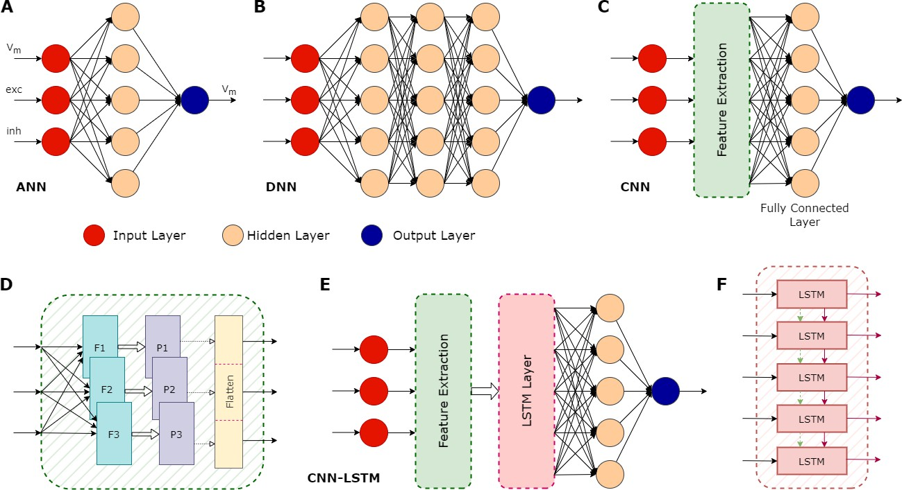
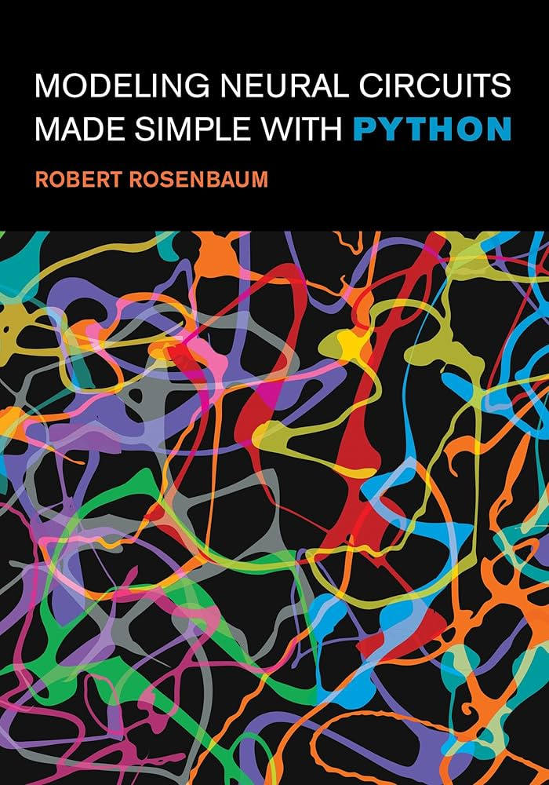
Types of Neural Circuits & Their Functions
Convergent: Multiple neurons converge onto one, integrating information.
Divergent: One neuron projects to many, widely distributing information.
Oscillatory: Recurrent connections create rhythmic activity (sleep-wake cycles).
Feedback: Connections create loops for self-regulation. Specific circuit types influence information processing and output. [Image: Examples of each circuit type]

Slide 4
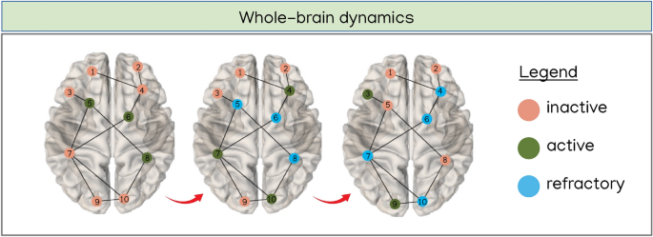
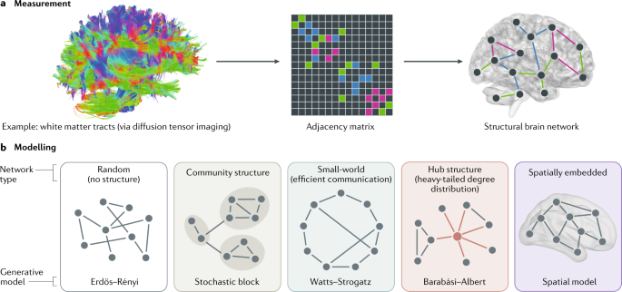
Computational Neuroscience Modeling
Computational neuroscience uses mathematical models and simulations to study neural circuits. Models range from simplified abstractions to detailed representations. This allows testing hypotheses, predicting behavior, and investigating effects of perturbations or disease (e.g., simulating excitation spread to understand stimulus response). [Image: Example of a computational model]

Slide 5
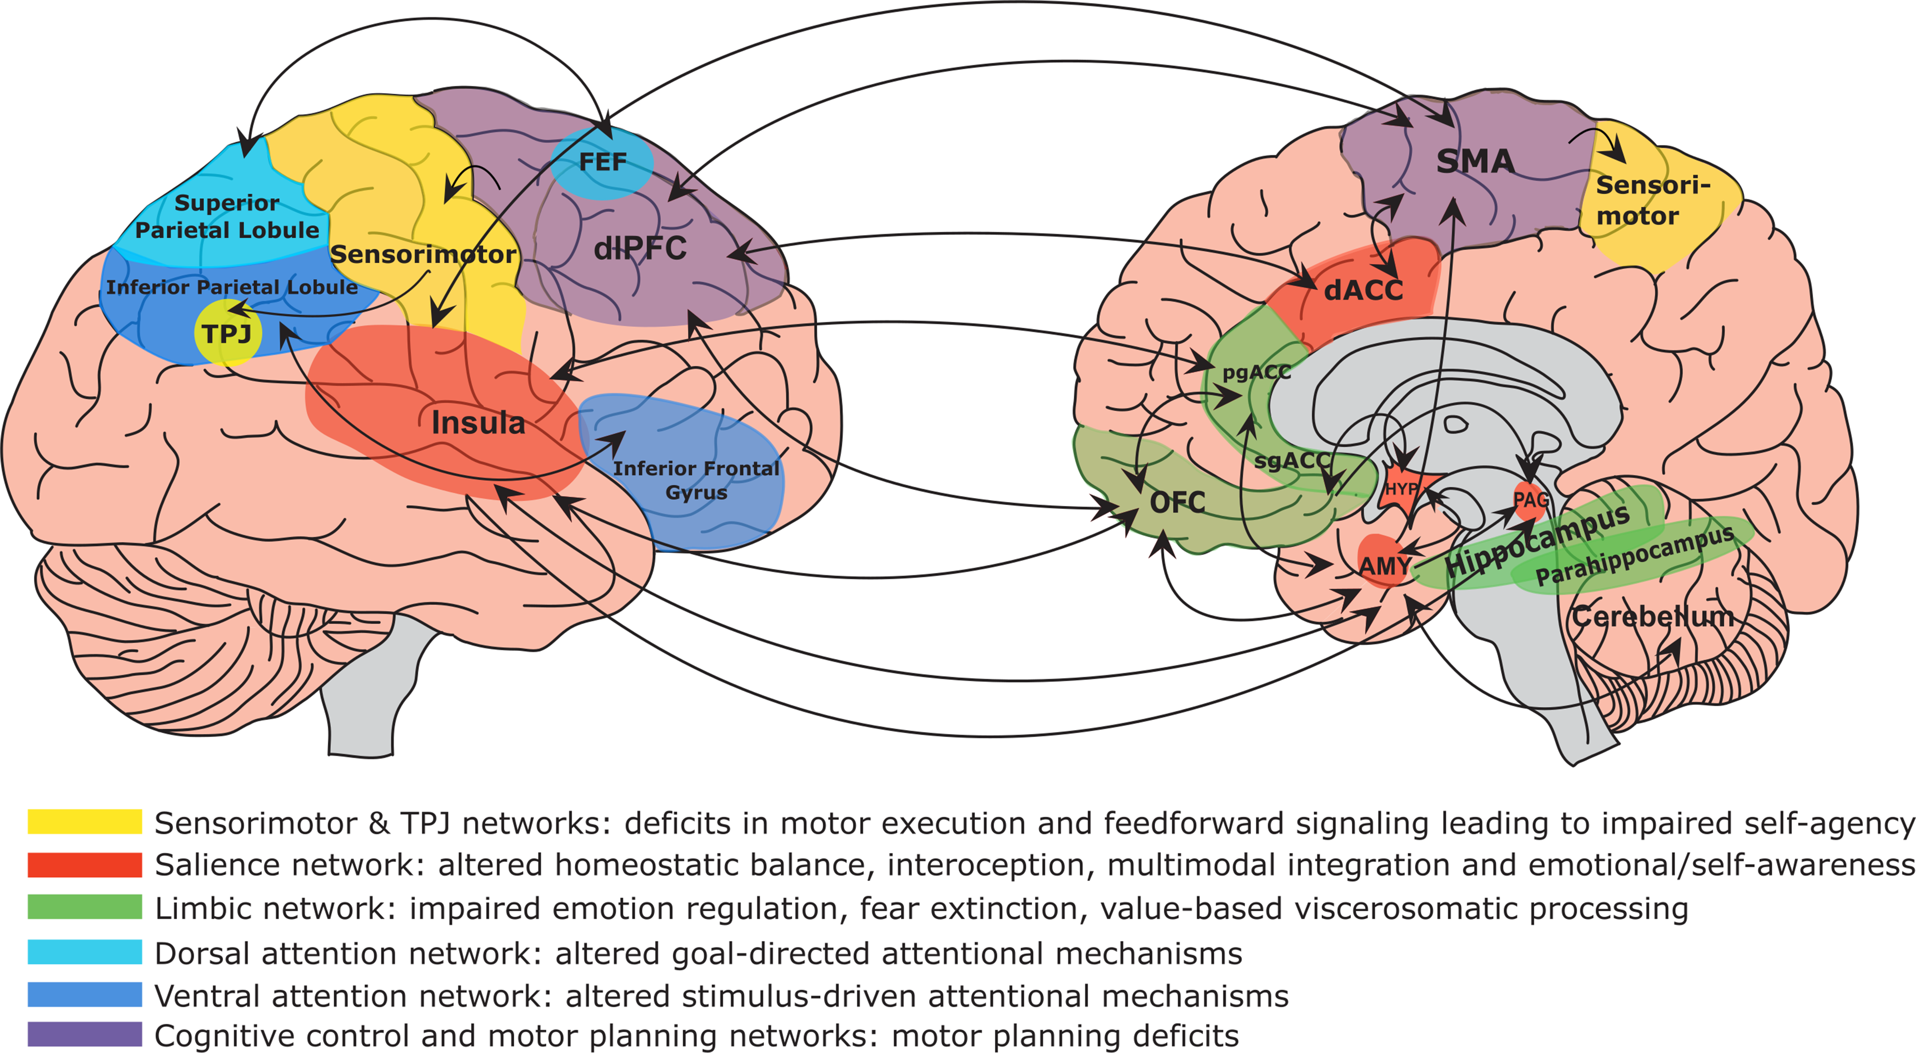
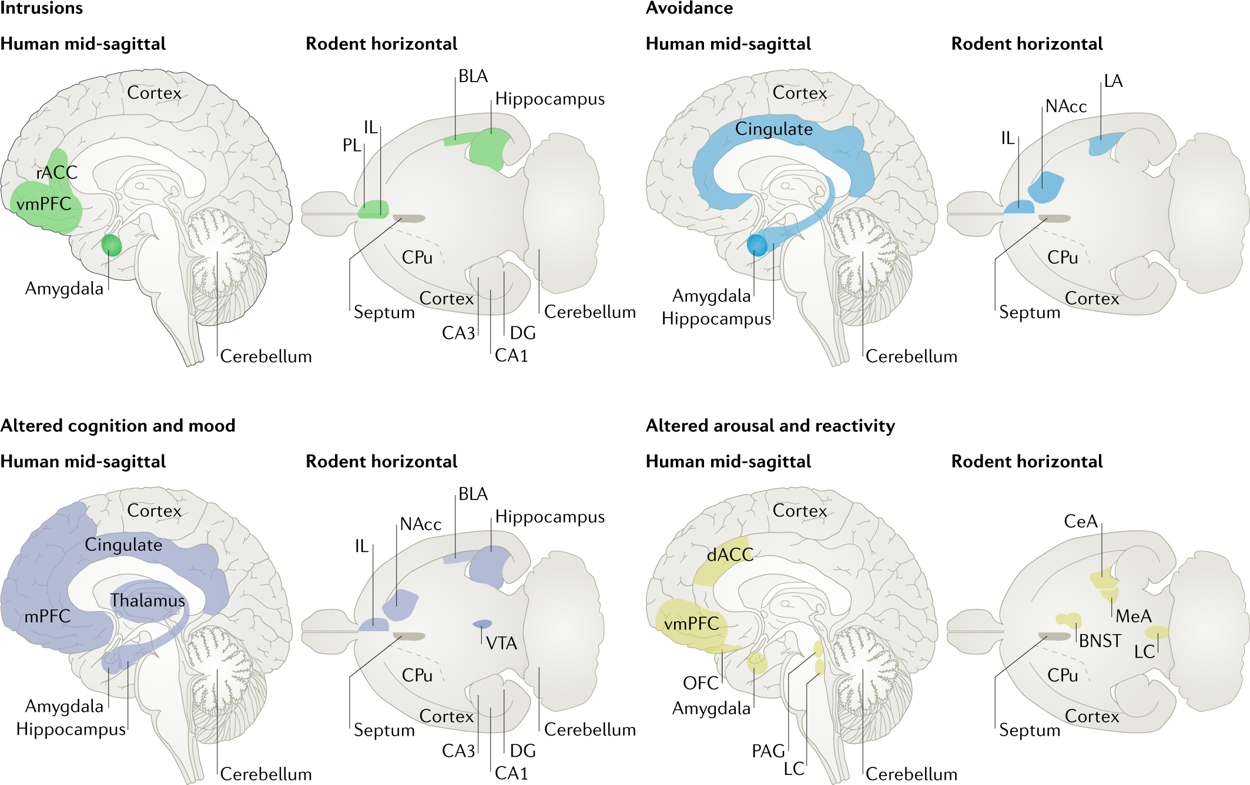
Examples of Neural Circuits and Dysfunction
Sensory Processing (Visual Cortex): Processes visual information, extracting features.
Motor Control (Cerebellum): Coordinates movement.
Memory (Hippocampus): Forms new memories.
Emotional (Amygdala): Processes emotions (fear, anxiety).
Circuit dysfunction leads to neurological and psychiatric disorders (Parkinson's, anxiety disorders). [Image: Brain regions highlighting relevant circuits]

Slide 6
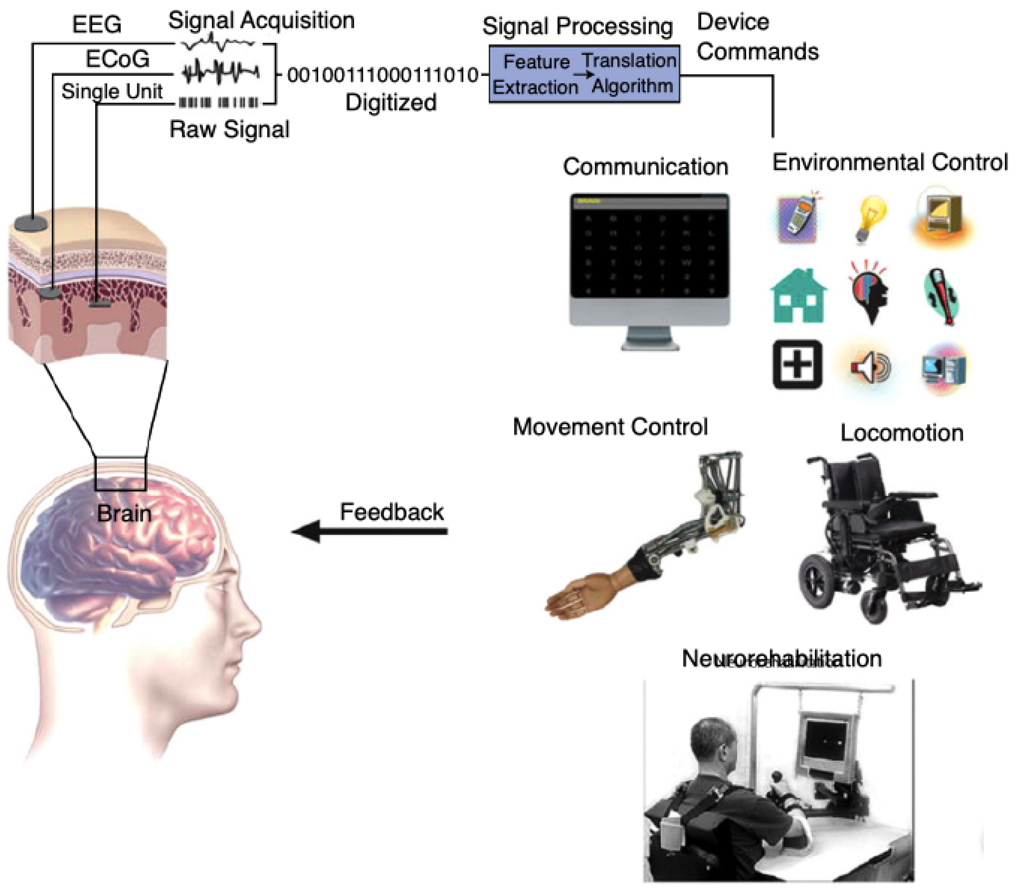
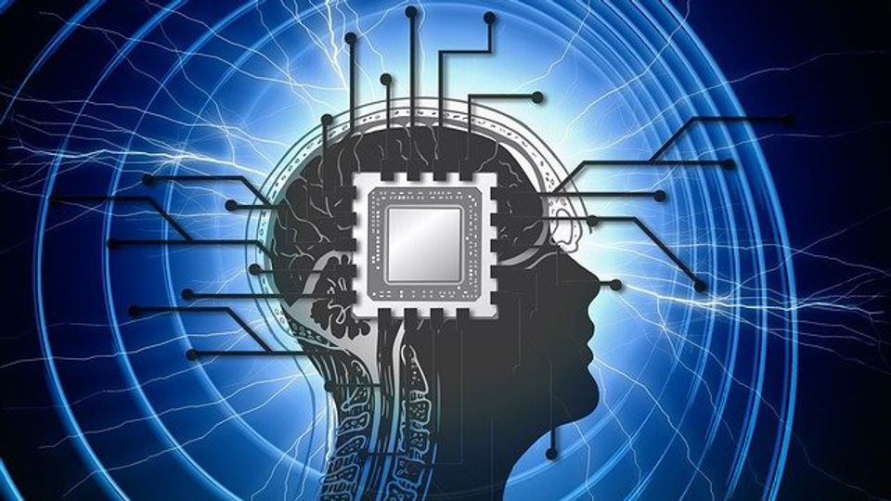
Structural and Functional Connectivity
Structural Connectivity: Physical connections between brain regions (white matter tracts). Mapped using DTI and tractography (e.g., corpus callosum integrity). Shows information transmission pathways and regional interaction. [Image: Brain showing major white matter tracts]
Functional Connectivity: Statistical dependencies between brain region activity (fMRI). Reveals networks working together (e.g., visual cortex and parietal lobe during visual attention). [Image: fMRI activation showing correlated regions]

Slide 7
Connectomics and Graph Theory
Connectomics: Comprehensive mapping of neural connections at all scales (synapses to large brain regions). A complete connectome would revolutionize our understanding of brain organization. [Image: Conceptual illustration of a connectome]
Graph Theory: Mathematical framework for representing and analyzing brain connectivity (nodes as regions, edges as connections). Measures like degree, clustering, and path length reveal network topology and efficiency (small-world properties). [Image: Graph representation of a brain network]

Slide 8
Applications of Brain Connectivity Mapping
Used to study brain development, aging, and disease (Autism, Alzheimer's). Informs development of targeted therapies and personalized medicine. Identifying connectivity disruptions guides interventions to restore function. [Image: Examples of altered connectivity in disease]

Slide 9
Computational Models of Neural Circuits: Definitions
Models range from single neuron to large-scale networks. Key concepts:
* Neuron Models: (Hodgkin-Huxley, integrate-and-fire)
* Synaptic Plasticity: (LTP, LTD)
* Network Connectivity: (Graphs, matrices)
* Network Dynamics: (Oscillations, synchronization)
* Model Validation: Comparing model predictions with experimental data. [Image: Different neuron model types]

Slide 10
Examples and Applications of Computational Models
Single-Neuron Models: Detailed biophysical properties or simplified firing behavior.
Network Models: Simulate interactions (RNNs, feedforward networks).
Large-Scale Brain Models: Simulate large brain regions (computationally intensive).
Applications: Understanding brain function, drug discovery, brain-computer interfaces, prosthetics, AI. [Image: Examples of different model types and their applications]

Slide 11
Hypothetical Scenario: Visual Perception Modeling
Modeling the visual cortex (neuron types, connections, plasticity) to simulate responses to visual stimuli. Testing hypotheses on information processing (object recognition, attention). Comparing model predictions with neurophysiological data refines understanding of neural mechanisms. [Image: Simulated visual cortex response to different stimuli]

Slide 12
Brain Network Dynamics and Plasticity: Definitions
Dynamics: Constantly changing activity patterns within and between brain regions, driven by neuronal interactions. Different brain states have distinct dynamic patterns. [Image: Example of changing brain network activity]
Plasticity: Brain's ability to reorganize itself by forming new connections. Adaptability allows for learning, skill acquisition, and injury recovery. Occurs at multiple levels (synaptic, structural, functional). [Image: Illustration of synaptic plasticity]

Slide 13
Types of Plasticity & Interplay with Dynamics
Synaptic: Changes in connection strength (LTP/LTD)
Structural: Changes in brain structure (new synapses/neurons)
Functional: Changes in brain region interaction
Dynamics and plasticity are intertwined; activity patterns influence structural changes, and structure constrains activity patterns. This interplay drives adaptation and learning. [Image: Diagram showing the interplay between dynamics and plasticity]

Slide 14
Examples and Real-World Applications
Example: Learning to ride a bicycle (initially multiple regions, then efficient integration). Applications: Neurorehabilitation, education, mental health, AI. [Image: Brain regions involved in bicycle riding]

Slide 15
Neurological Disorders and Brain Circuits: Overview
Neurological disorders affect the central and peripheral nervous systems (epilepsy, Parkinson's, Alzheimer's, MS, stroke). Disruptions in circuits cause diverse symptoms. Computational modeling helps understand and treat these disorders. [Image: Examples of neurological disorders and affected brain regions]

Slide 16
Examples of Disorders and Affected Circuits
Parkinson's: Basal ganglia circuit dysfunction (dopamine neuron degeneration).
Epilepsy: Abnormal cortical circuit electrical activity.
Alzheimer's: Multiple brain regions affected (hippocampus, prefrontal cortex). [Image: Detailed illustration of affected circuits in each disorder]

Slide 17
Computational Modeling of Neurological Disorders
Computational models simulate neuronal activity, predict disease progression, and evaluate therapies. Simulating synaptic strength or connectivity changes helps understand Parkinson's symptoms and test treatments. [Image: Example of a computational model of a neurological disorder]

Slide 18
Hypothetical Scenario: Modeling a Novel Disorder
Modeling a hypothetical disorder with spatial navigation and memory deficits. Simulating hippocampal circuit disruptions (reduced plasticity, altered excitability) to identify mechanisms and therapeutic targets. [Image: Simulated hippocampal circuit activity showing disruption]

Slide 19
Brain-Computer Interfaces (BCIs): Definition
BCIs enable direct communication between brain and external devices, bypassing neuromuscular pathways. Can be invasive (implanted electrodes) or non-invasive (scalp sensors). [Image: Illustration of invasive and non-invasive BCIs]

Slide 20
Types of BCIs and Their Mechanisms
Categorized by invasiveness and signals used (EEG, implanted microelectrode arrays, MEG). Signal processing decodes brain activity into commands. [Image: Examples of different BCI types and their mechanisms]

Slide 21
Applications and Ethical Considerations
Applications: Rehabilitation, assistive technology, augmentation, research, gaming. Ethical considerations: Privacy, safety, equity, agency. [Image: Examples of BCI applications]

Slide 22
Hypothetical Scenario: Restoring Motor Function
BCI implanted in a quadriplegic patient to interface with motor cortex neurons. Training allows control of robotic arms or exoskeletons, restoring independence. [Image: Patient using a BCI to control a robotic arm]

Slide 23
Data Acquisition and Preprocessing
Acquiring neural signals is challenging (noise and artifacts). Preprocessing techniques (filtering, artifact rejection, feature extraction) improve data quality. Examples: ICA for removing eye blinks, wavelet transforms. [Image: Example of EEG data before and after preprocessing]

Slide 24
Decoding Neural Signals: Machine Learning
Machine learning decodes neural signals into commands (LDA, SVM, ANNs, RNNs). Algorithm choice depends on data type, accuracy, and computational constraints. [Image: Example of machine learning algorithm applied to neural data]

Slide 25
BCI Performance Evaluation and Optimization
Data science assesses accuracy, speed, and robustness (ITR, error rate). Optimization techniques (hyperparameter tuning, model selection) improve performance (cross-validation). [Image: Graph showing BCI performance metrics]

Slide 26
Ethical Considerations and Data Privacy
Ethical concerns: Data privacy, security, bias. Robust security and bias mitigation are crucial for responsible development. [Image: Illustration of ethical considerations related to data privacy and security]

